Slide 1

Diagnose the root cause of these crashes
Donald Thulane Makhubela

Slide 2
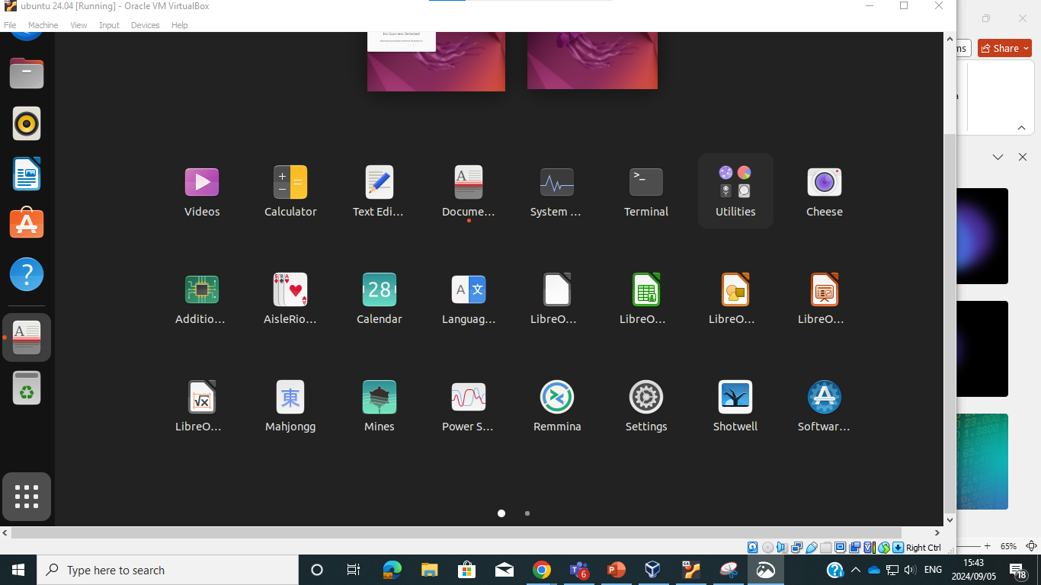
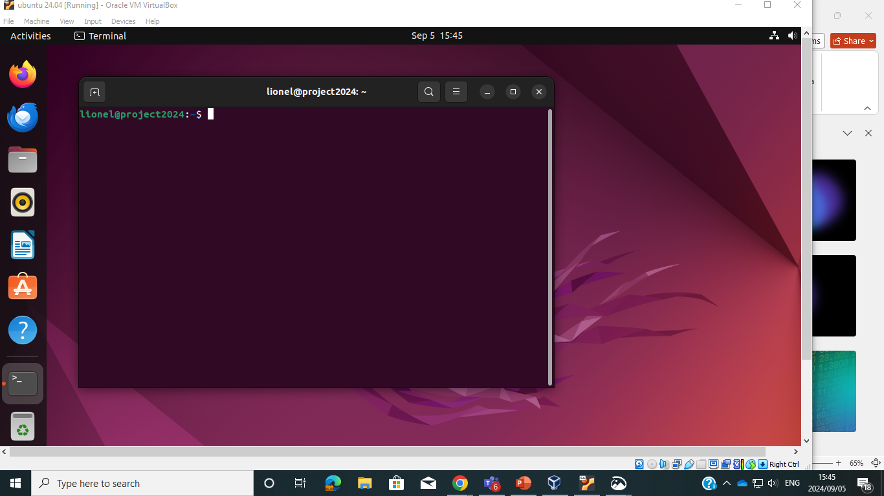

Slide 3
.”
View System Logs: Run the command journalctl -xe to view recent system logs. Look for any error messages or warnings around the time your crashes occurred.
Filter Logs by Date: If needed, filter logs by date using journalctl --since "YYYY-MM-DD" --until "YYYY-MM-DD". Adjust the dates to match the time of your crashes.
Open Terminal: Press Ctrl + Alt + T to open the terminal.
Step 1: Check System Logs
-

Slide 4
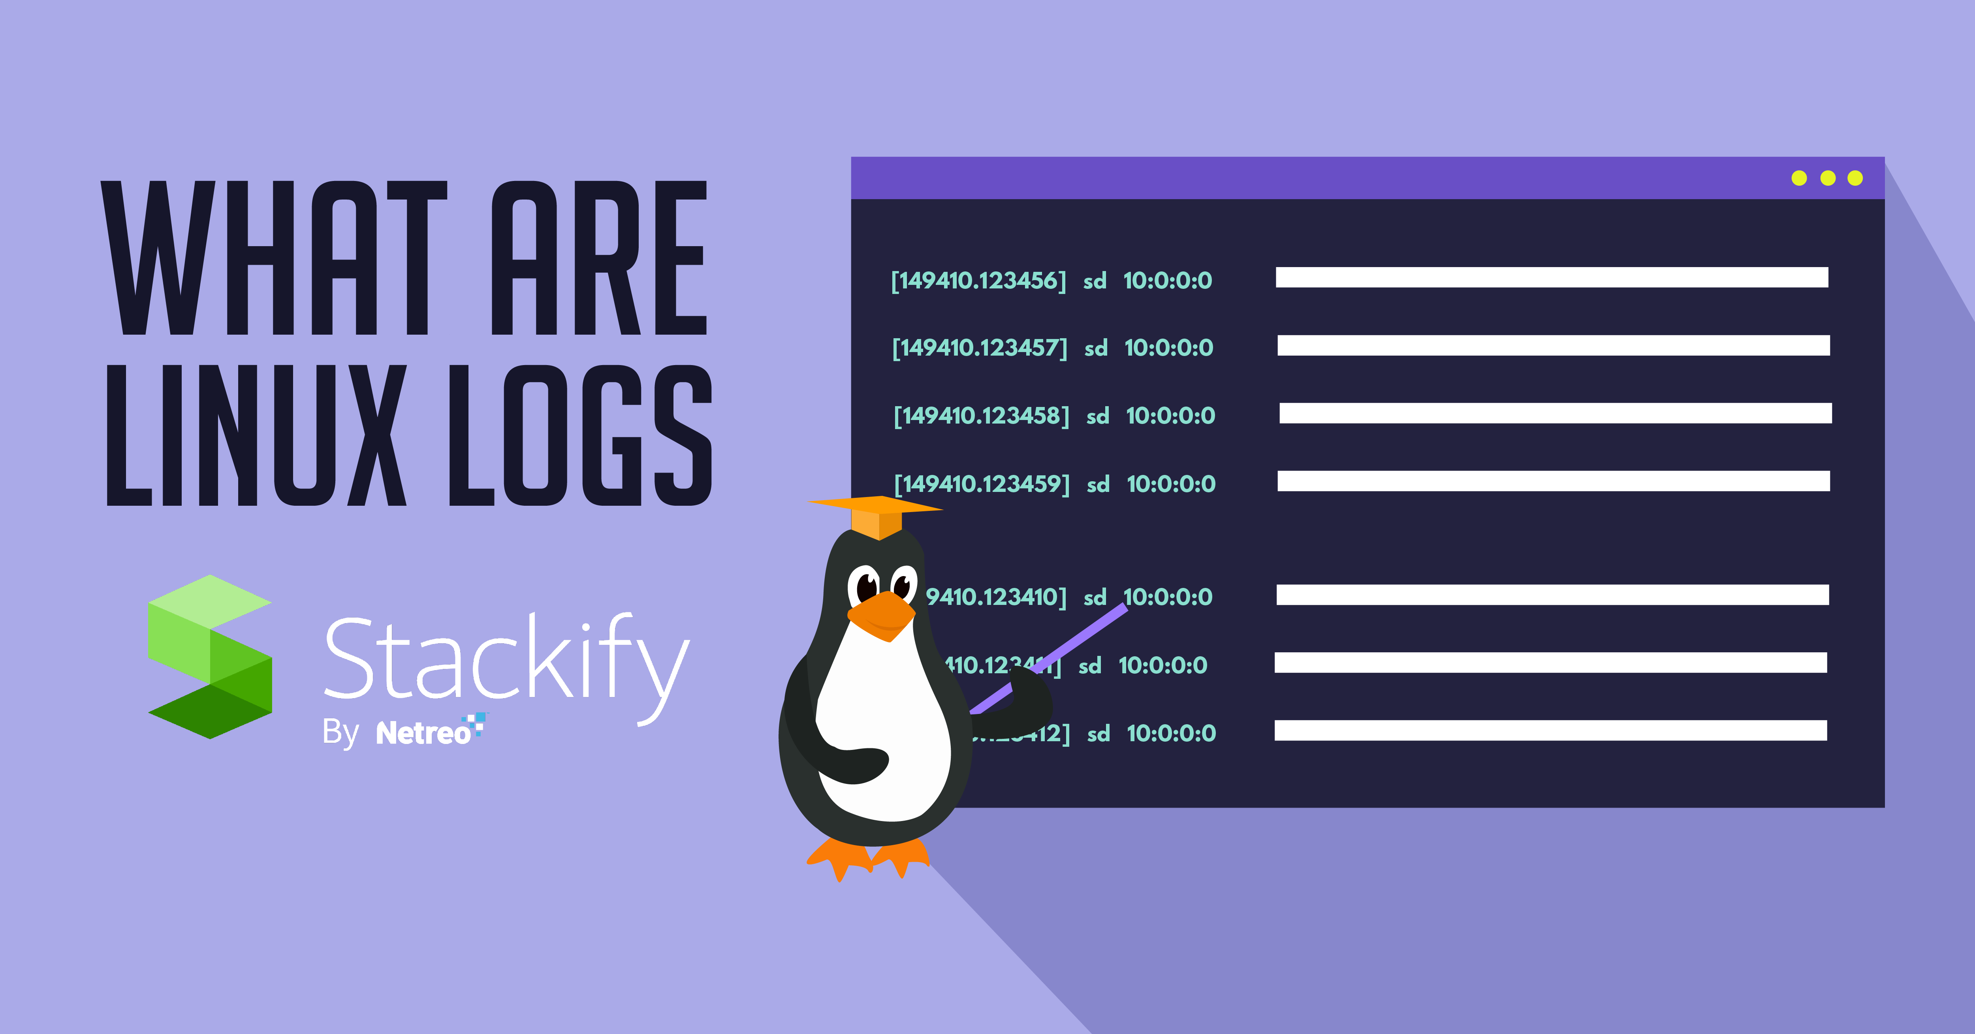
Step 1: Check System Logs

Slide 5
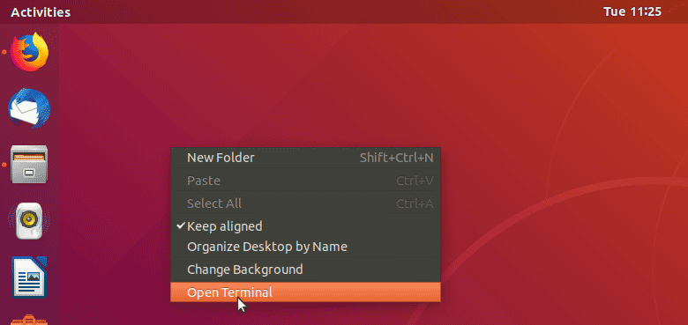
Open Terminal: Press Ctrl + Alt + T to open the terminal.

Slide 6
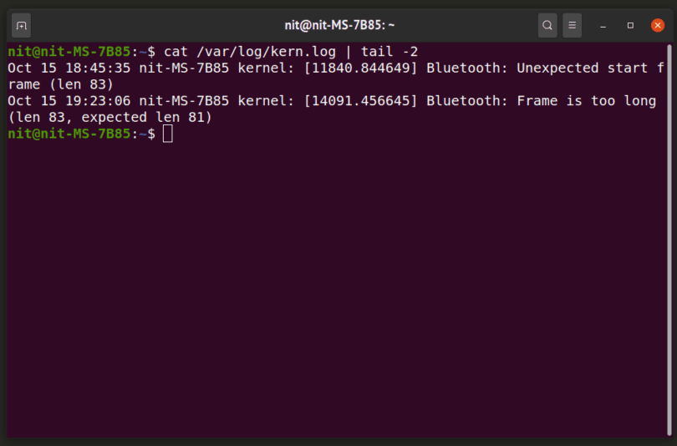
View System Logs: Run the command journal ctl-xe to view recent system logs. Look for any error messages or warnings around the time your crashes occurred.

Slide 7
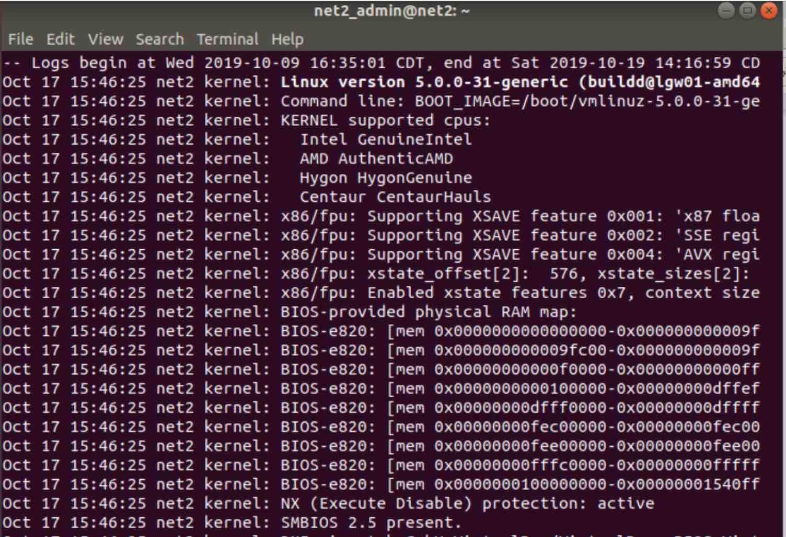
Step 2: Analyze Application Logs
Locate Application Logs: Check the specific application's log files. These are often found in /var/log/ or within the user's home directory, typically in a hidden folder like .appname/.
View Logs: Use cat, less, or tail -f to view these logs. For example, tail -f /path/to/application/logfile.log will show real-time updates.

Slide 8
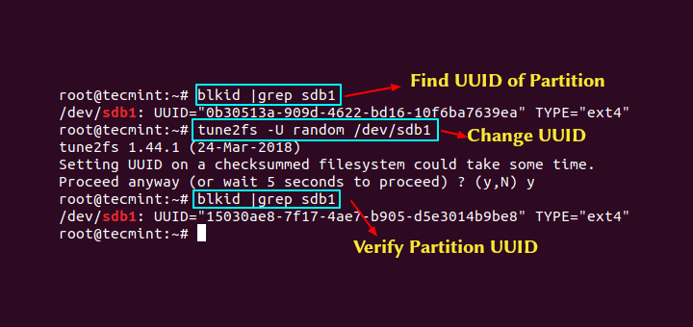
Step 3: Identify Recent Changes
Check Installed Packages: Run dpkg -l (for Debian-based systems) or rpm -qa (for Red Hat-based systems) to see recently installed or updated packages.
Verify Libraries: Use ldd /path/to/application to list the shared libraries used by the application. Look for any discrepancies or missing libraries.

Slide 9
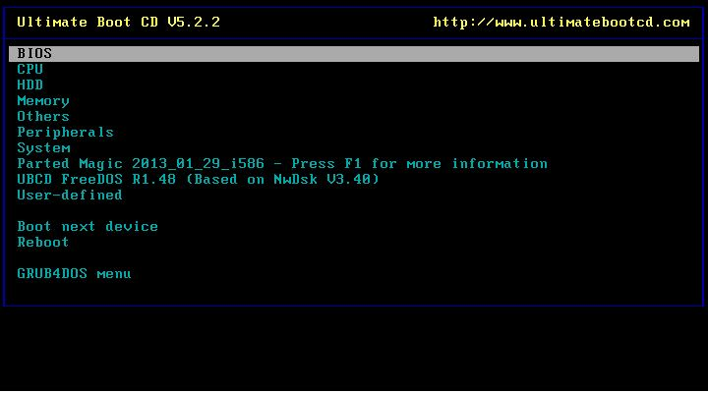
Step 4: Run Diagnostic Tools
Memory Test: Run memtest86+ to check for memory issues. This can be done from the GRUB menu if you have memtest86+ installed.
Disk Check: Use fsck to check your filesystem for errors. Make sure to unmount the filesystem before running this tool to avoid data corruption.

Slide 10
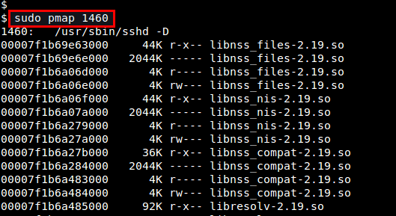
Step 5: Check for Conflicting Libraries
Find Conflicting Libraries: Use ldd /path/to/application to check if there are any conflicts or mismatches in the library versions.
Resolve Conflicts: If you identify a conflicting library, consider updating or reinstalling the library. Use package managers like apt, yum, or dnf to update libraries.

Slide 11
Step 6: Consult Forums and Documentation
UbuntuForums 'system-info' Script
General The Ubuntu Forums "system-info" script queries the users computer and prepares a hardware and system configuration report, so that users & helpers can see details of your system. Details
Creates the file `system-info.txt` at the base of the user's home directory.
Sanitizes, masks all sensitive info, like IP addresses, MAC addresses, Full FQDN and Serial numbers, automatically in a meaningful way.
The script displays the unmasked report results within the 'less' utility to review the results, one screen at a time. To navigate from there, press the space bar, left, right, up, down, page up or page down keys to navigate. If in a graphical terminal session, you can also use mouse navigation. Press the "q" key to exit "less" and continue. It will print the final report and offer to upload to pastebin site.
Offers to post the results to the Ubuntu `pastebinit` provider if that program is installed, and a sufficiently reliable internet connection is available. This is the easiest way to share the sanitized results with the Ubuntu Community for support. It has 3 other fallback methods to upload the pastebin of 'pastebinit' is not installed, using either 'curl', 'wget', or netcat ('nc') After successful upload to the pastebin, it will both display and log the URL of the uploaded report (`~/system-info-link.log`), for you to copy and paste in your post on the Ubuntu Forums. (See note on missing programs below.)
If not uploaded to a Pastebin, if the 'system-info.txt' report exceeds 19.5 kB in size, it will offer to create the archive `system-info.tar.gz` for you to be able to add as an attachment to a Forum Post.

